Slide 1
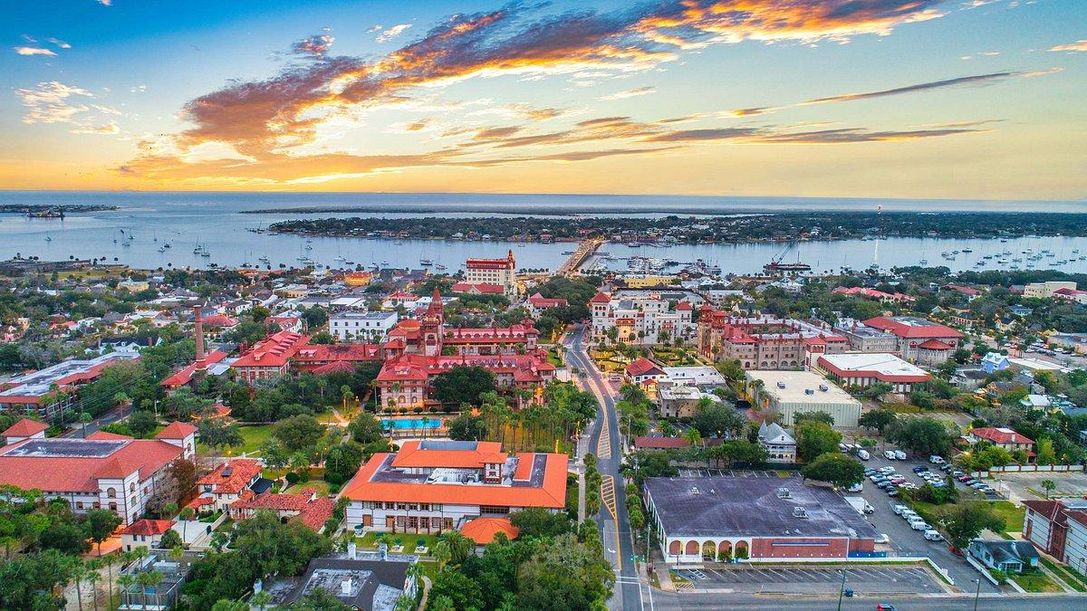
49th Diocesan Assembly
July 20-24, 2026
St. Augustine/Vilano Beach, Florida

Slide 2
Diocese of the South
49th Assembly 2026
His Eminence Alexander
Archbishop of Dallas and the South
Bishop Gerasim
Bishop of Fort Worth
Archpriest Marcus C. Burch, Chancellor
Fr. Peter Robichau, Secretary
Fr. Jason Foster, Director of Development
Ms. Mary Harkins, Treasurer
.

Slide 3
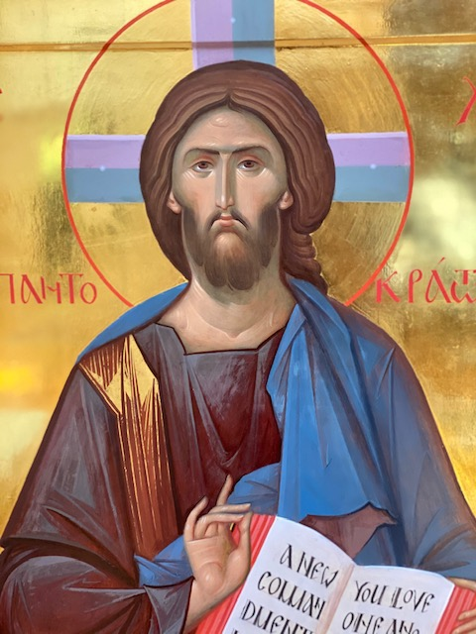
Opening Prayer, Welcome, and Call to Order
O Heavenly King,
the Comforter, the Spirit of Truth,
Who art everywhere and fillest all things
Treasury of blessings
and Giver of Life;
come and abide in us,
and cleanse us from every impurity,
and save our souls, O Good One.

Slide 4
Agenda
Wednesday, July 22, 2026 (3 - 5 pm)
1. Opening Prayer, Welcome, and Call to Order
2. Approval of Bylaws
3. Patrick Gorman Office of Pastoral Life
4. Report of Audit Committee
5. Diocesan Council Elections
6. 2025/26 Reports
a. Monasteries
b. Deaneries
c. Metropolitan Council
7. Upcoming Conferences and Assemblies
a. 2027 Pastoral Conference (Date)
b. 2027 DOS Assembly (Date)
8. Closing Prayer
The minutes, budget, and all reports are available at dosoca.org and/or have been distributed via email. Please download to your laptop (or other device) or print your own copies for use at the assembly.

Slide 5
Elections:
a. DOS Metropolitan Council (MC)
b. DOS Diocesan Council (DC)
c. DOS Audit Committee

Slide 6
2025/2026 Reports
(distributed via email/web; questions only)
a. Monasteries (Nativity, Archangel Michael, Ss. Mary & Martha)
b. Deaneries
Appalachian
Carolinas
Southeastern (Atlanta)
North Florida (Orlando)
Mississippi River
South Florida (Miami),
Southcentral (Dallas)
c. Metropolitan Council

Slide 7
Upcoming Conferences
& Assemblies
2027 Pastoral Conference - Holy Apostles, Bixby, OK.
February 8 - 12
2027 DOS Assembly will be at St Innocent in Macon, Georgia
July 26 - 30, 2027

Slide 8
Closing Prayer
It is truly meet to bless you,
O Theotokos,
ever blessed and most pure
and the Mother of our God,
more honorable than the Cherubim,
and more glorious beyond
compare than the Seraphim,
without corruption you gave
birth to God the Word,
true Theotokos we magnify you.

